Slide 1

INTRODUCTION
-- Mounika Voriganti [BDS]

Slide 2
What is tableau ?
It is a powerful and fastest growing data visualization tool used in the Business Intelligence Industry.
It helps in simplifying raw data in a very easily understandable format.
It also allows non-technical users to create customized dashboards.
Tableau is a visual analytics platform transforming the way we use data to solve problems empowering people and organizations to make the most of their data.
It was founded in 2003 in Mountain View, California, and is currently headquartered in Seattle, Washington.

Slide 3
Option of the start page of tableau desktop.
The start page consists of three panes: Connect, Open, and Discover.
Connect : Under to a file, connect to data stored in Microsoft Excel files, text files, Access files, Tableau extract files, and statistical files, such as SAS, SPSS, and R. Under To a Server, connect to data stored in databases like Microsoft SQL Server or Oracle.
Open: You can open your existing workbook or workbook in which you have work earlier. By clicking on open you can access earlier version of workbook that you have created for visualization.

Slide 4
Open: You can open your existing workbook or workbook in which you have work earlier. By clicking on open you can access earlier version of workbook that you have created for visualization.
Discover : In this section , we can read blog posts and news about Tableau, and also training videos and tutorials to help you get started.

Slide 5
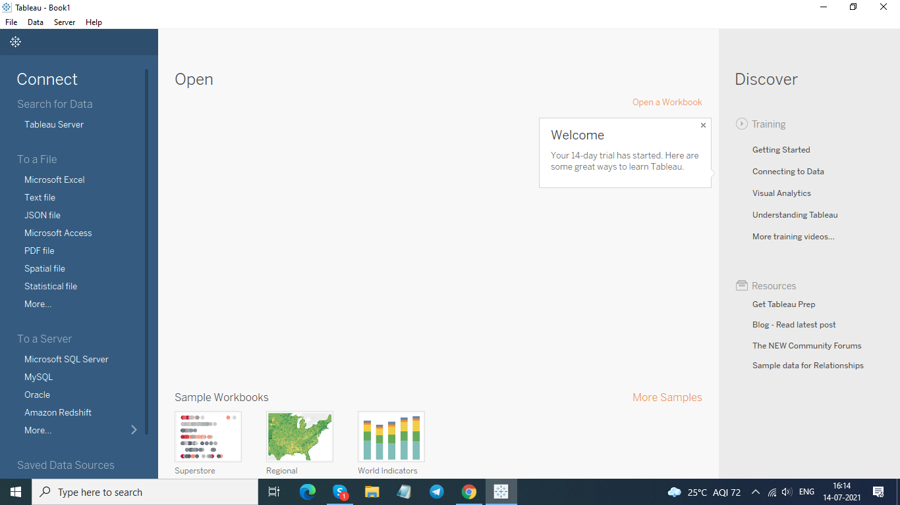

Slide 6
Tableau architecture :
Basically Tableau architecture is basically divided into 2 parts.
Create
Share
Tableau Server
Tableau Online
Reader
Create help us to create the visualization
share component help in sharing whatever we have created

Slide 7
Steps of process flow of BI Project
BI has a direct impact on organization's strategic, tactical and operational business decisions.
BI tools perform data analysis and create reports, summaries, dashboards, maps, graphs, and charts to provide users with detailed intelligence about the nature of the business.
The process flow of BI project is
1. Business understanding
2. Data understand
3. Data Preparation
4. Modeling
5. Evaluation
6. Deployment

Slide 8
Thank You

